Slide 1
Urban Youth, ICTs, and Civic Engagement in Asia
EAI Seminar September 17, 2010
Weiyu Zhang (PhD, UPenn), Assistant Professor
Communications and New Media, National Univ. of Singapore

Slide 2
Agenda
1
Youth and ICTs
2
Research Design
3
Singapore
4
India
5
China
6
Q & A

Slide 3
Youth and ICTs

Slide 4

Why Youth?
Youth as a pivotal group
Youth as a problematic group
Youth and risky behaviors
An apathetic generation
The ’80ers and the ’90ers
Notes:
no direct experience of Maoist socialism, a vague memory of 1989, a direct experience with economic reform and economic development which is taken for granted, singletons or having fewer siblings due to the one-child policy, and a flourish of information due to the reform of mass media and the emergence of new media

Slide 5




Why ICTs?
Rapid growth of new media penetration
Innovative usage of new media
Social impacts of new media
Education
Workplace
Family
Consumers

Slide 6

Why youth and ICTs?
The Net Generation (Tapscott, 2009)
Born after 1980 (or in late 1970s)
ICTs Make youth innovative, collaborative, and want more fun
ICTs Make youth dumb, shameless, narcissistic, and hate working

Slide 7
Research questions
RQ1: Do youth use ICTs to engage in civic activities? If yes, How?
RQ2: Do ICTs change the relationship between youth and established institutions? If yes, How?
RQ3: Do ICTs change the nature of youth participation? If yes, How?

Slide 8
Research Design

Slide 9
Southeast Asia | Manila, Philippines | KL, Malaysia | Singapore
South Asia | Dhaka, Bangladesh | Colombo, Sri Lanka | Delhi, India
20-30 in-depth interviews
15-35 year old
Urban youth with full access to new media and have participated in some civic activities
5-10 focus groups
15-35 year old
Average youth with some access to new media

Slide 10
Science is “unavoidably comparative” (Lasswell, 1968)

Slide 11
Comparative Analysis
Four models (Livingstone, 2003)
what is unique about each case
tests the hypothesized generality of findings across cases such as the apathetic generation
systematic relations are sought, each case thereby serving as one unit or data point
compares cases insofar as they are systematically interrelated due to some underlying processes such as globalization

Slide 12
Comparative Analysis
Difficulties with the approach
Different yet comparable
The many variables problem
What to compare?

Slide 13
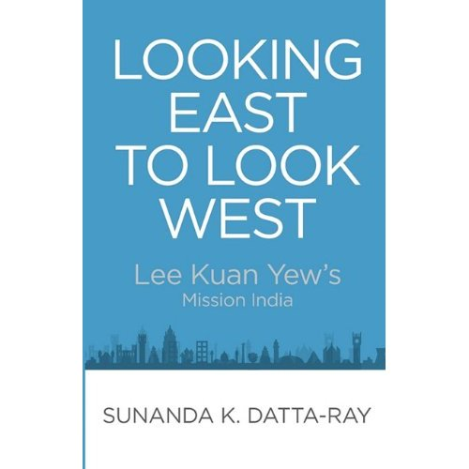
Looking east to look west?

Slide 14
Comparability?
Singapore vs. China
Size, economic development, racial relationship
Ethnic Chinese, authoritarian governance
India vs. China
Government system, language and culture
Size, economic development, regional influence

Slide 15
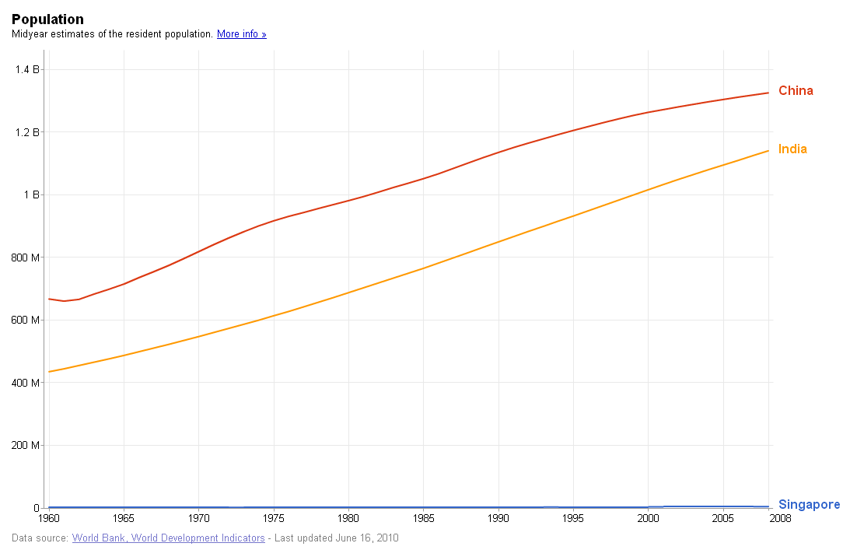
Population

Slide 16
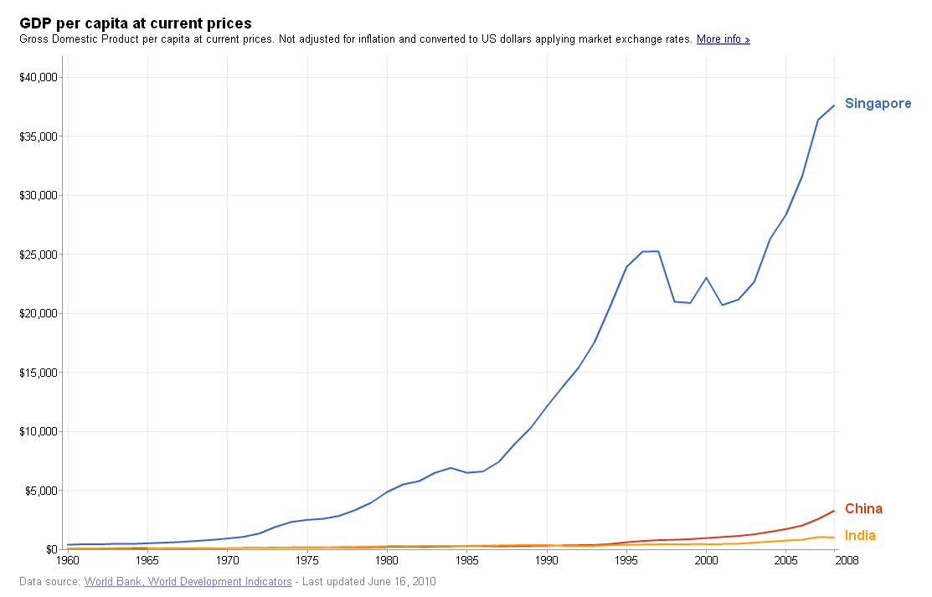
GDP per capita
Notes:
India: us $1016
China: 3266
Singapore: 37597

Slide 17
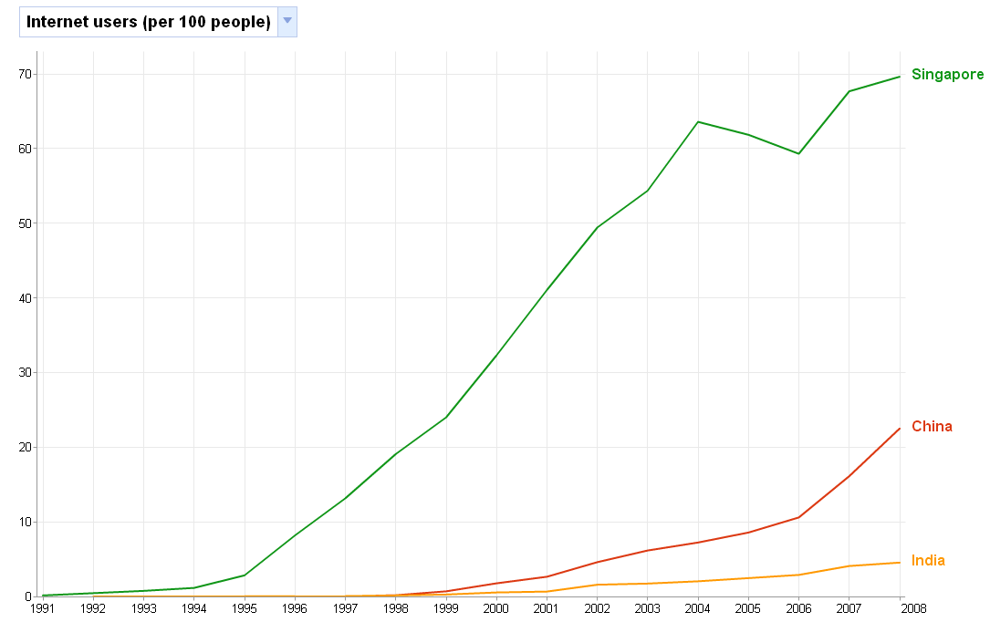
Internet penetration rate

Slide 18
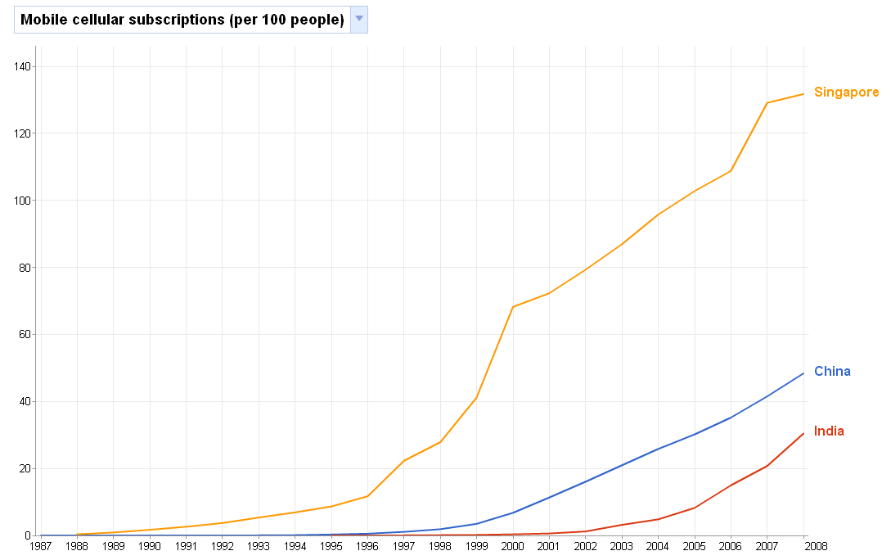
Mobile phone penetration rate

Slide 19
 | Beijing | Delhi | Singapore
Youth population (15-29 years old) | 27% (2008) | 30% youth (2005-2006) | 21% youth (2009)
Literacy rate | 97% | 82% | 97%
Mobile phones | 106/100 (CMMIT) | 174/100 (Vodafone) | 138/100 (DoS)
Internet | 48% among urban China (CNNIC & NBSC, 2008) | 71% among urban India (IAMAI, 2009) | 66% (DoS, 2005)
Youth policy | Gongqingtuan and All-China Youth Federation | Ministry of Youth Affairs and Sports etc | National Youth Council etc
Notes:
http://it.sohu.com/20061027/n246042559.shtml

Slide 20
Singapore
Internet as information sources
SNS as dissemination tool
Mobile phones mainly for interpersonal contact
Online multimedia content, Open source platforms to facilitate international collaboration
Knowledge-building
Choosing issues
International vision
Being alien to local issues
Institution-bypassing
Speakers’ corner

Slide 21
India
TV and newspaper as major information sources
Mobiles are heavily used for almost all purposes
SNS and online chats better in information dissemination
Fill in the inadequacies
Social services focused
Self satisfaction and self fulfillment
I am no less than a star…more like a God!

Slide 22
Common Trends
Rejection of traditional politics
Embrace new engagement
local/relevant/seeable
Decreasing reliance on mass media
Lack of new discourses
Influence of ICTs contingent on political culture

Slide 23
China!
Contentious politics
Protests, collective incidents, dissidents
Deliberative politics
Authoritarian deliberation
In-between
Volunteer work and GNGOs
Hobby clubs and cultural consumption
Discursive participation via online discussions

Slide 24
Thank You!
cnmzw@nus.edu.sg

